Slide 1

VideoVigil
Mubashir Ahmed : FA20-BSE-063
Supervisor: Mam Neeli Khan
Department of Computer Science
COMSATS University Islamabad, Abbottabad

Slide 2
Agenda
Brief Introduction
Scope
Functional Requirements
Non-functional Requirements
Diagrams
Test
Detail on 3rd Iteration (or 100%)
Conclusion

Slide 3
Project Introduction
Automatic Violence Detection: Uses AI to identify violence in online videos.
Web Browser Extension: Easy to install and integrates seamlessly with your browser.
Enhanced Online Safety: Filters out violent content for a safer online environment.
User Wellbeing: Prioritizes user safety and well-being for a considerate online space.

Slide 4
Project Scope
AI-powered Violence Detection: Develop a deep learning model to identify violence in online videos.
Web Browser Shield: Deploy the model as a browser extension for real-time content warnings.
Empowering Users: Promote responsible online behavior by giving users control over video content.

Slide 5
Functional Requirements
Detect : Detect instances of violence and sensitive content within online videos.
Generate: Generate real-time warnings or alerts to inform users about potentially distressing content.
Ensure: Ensure compatibility with popular web browsers, including Chrome, Firefox, and Brave Browser
Implement: Implement YOLOv8 to detect instances of violence and sensitive content accurately..

Slide 6
Non-Functional Requirements
Performance: Achieve real-time video processing for timely detection.
Security: Protect user data and maintain confidentiality.
Compliance: Adhere to privacy regulations and standards.
Robustness: Remain resilient to variations in video conditions.

Slide 7
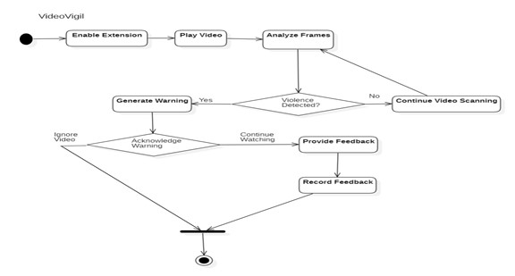
Activity Diagram

Slide 8
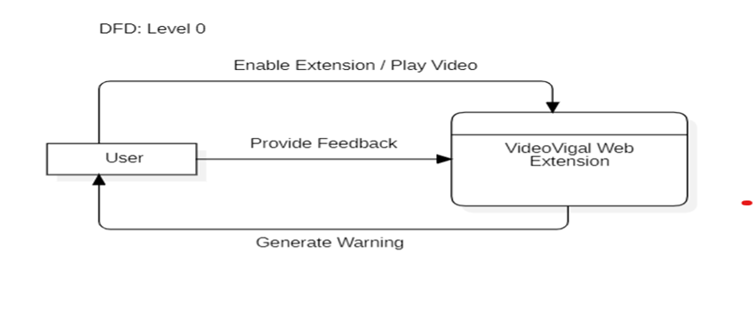
DFD (Level 0)

Slide 9
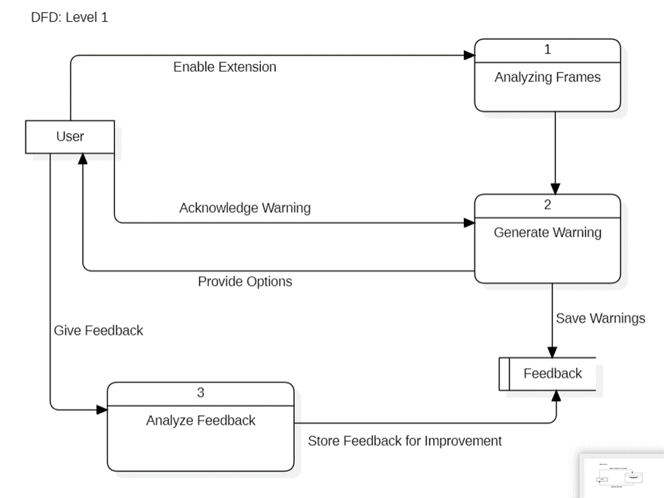
DFD (level 01)

Slide 10
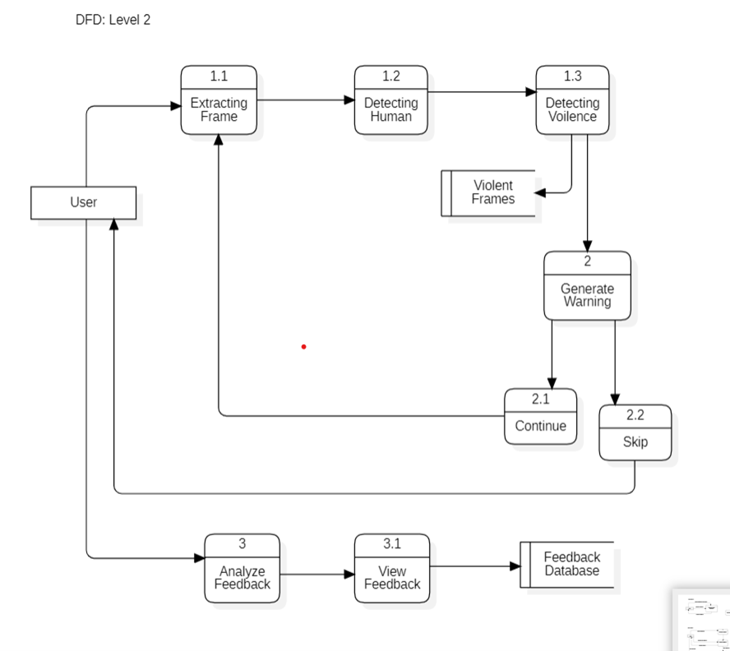
DFD (level 02)

Slide 11
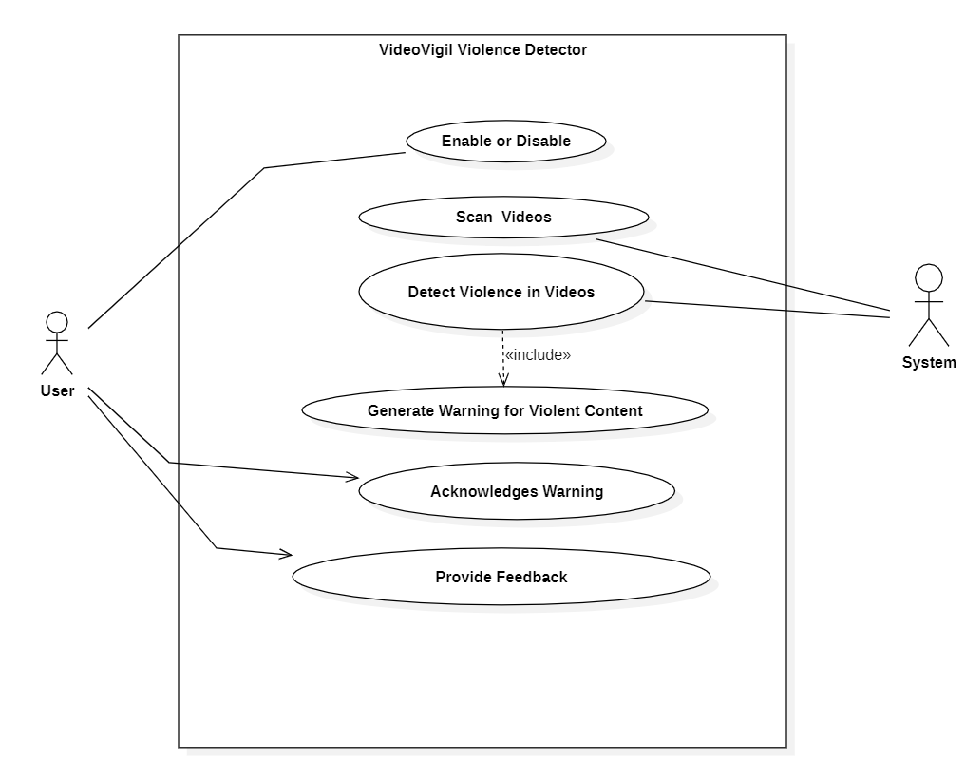
Use Cases Diagram

Slide 12
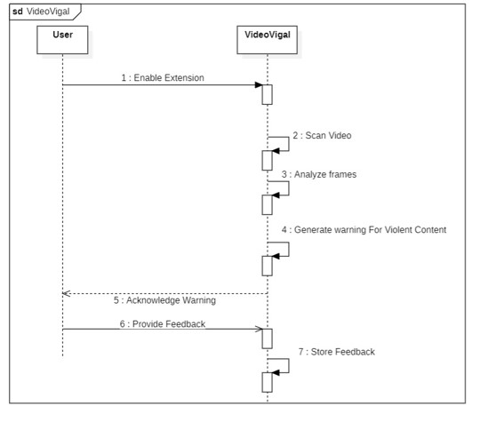
System Squence Diagram

Slide 13
Unit Testing
Unit tests were performed on individual components: Test 1: Video Processing Objective: Confirm the processing of video. Test Case: Video Processing Expected Result: Extract Frames match video content
.
No | Test case/Test script | Attribute and value | Expected result | Result
1. | Video Frame Extraction | Sample Video File using Youtube link | Extract Frames match video content | Pass
2. | Video Segmentation | Sample Video File, Segmentation threshold | Segmented video segments match scene transitions | Pass

Slide 14
Functional Testing
Test 1: Violence detection
Objective: Confirm that the extension detects the violence timely.
Test Case: Test violence detection with sample video
Expected Result: Detects violent scenes accurately.
No | Test case/Test script | Attribute and value | Expected result | Result
1 | Test violence detection with sample video | Sample video file | Detects violent scenes accurately | Pass
2 | Test non-violent video detection | Sample video file | Detects violent scenes accurately | Pass

Slide 15
Integration Testing
Integration tests verified the interaction between the web browser and the video playing extension
Test 1: Video Analysis Warning
Objective: Ensure that the model responds to the violence.
Test Case: Confirm the violation is generated accurate.
No. | Test case/Test script | Attribute and value | Expected result | Result
1. | Integrated video analysis and warning system | Sample video with violent scenes | Successfully detects violence and generates warnings | Pass

Slide 16
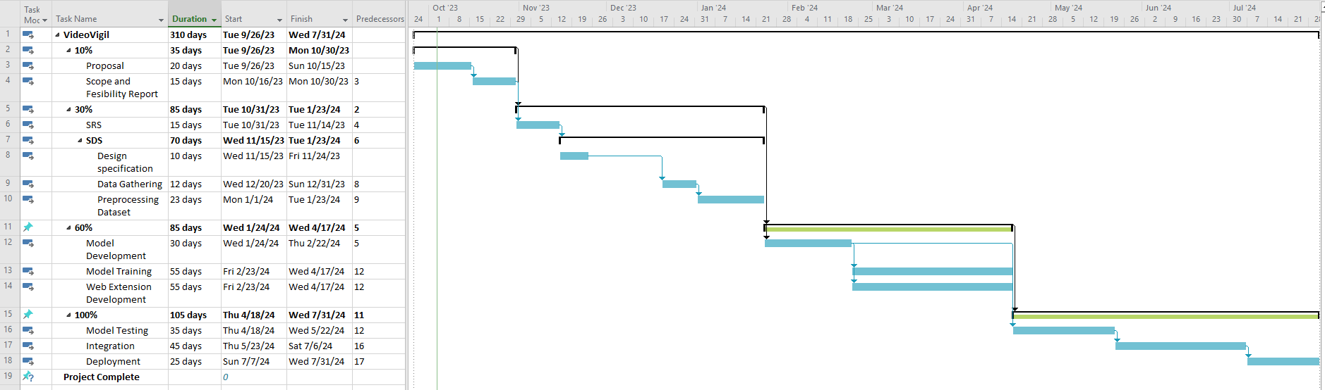
Gantt Chart

Slide 17
Summary of 100% Project Implementation
Dataset, Algorithms
Human Detection
Violence Detection
Model Training
Model Testing
Web Extension

Slide 18
THANK YOU

